Slide 1
Predicting Customer Next Visit
A Machine Learning Problem By:
Prerna Singhal

Slide 2
Business Problem
Here we have a dataset with 300k rows.
Each row represents a customer and with that we have a specific customer Information
We are provided the days the customer has visited the shopping mall in the span of 1000 days
As a business problem we have to predict on which weekday the customer will visit the mall in the week following the 1000th day.
Solving this problem will help the organisation to design the promotion packages for the target customers.

Slide 3
Assumption
As our dataset has visits in terms of day number ranging from 1 to 1001, we have made this assumptions that 1 is the beginning of the week i.e. Monday. Thus we have assigned numbers to the weekday as:
1: Monday
2: Tuesday…..
7: Sunday

Slide 4
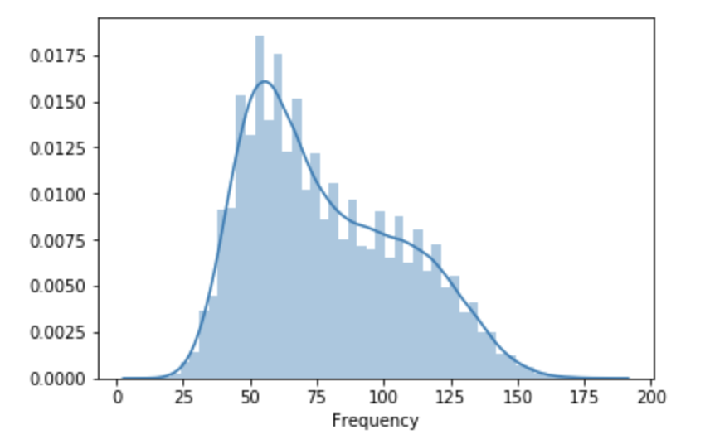
EDA - Frequency of visit
As seen in this graph, the number of times customer has visited the mall in the span of 1000 days lies in the range of 25-150 days.
There are some customers who have visited the mall more than 150 days. However, maximum of the customers are visiting 25-75 days in that span.

Slide 5
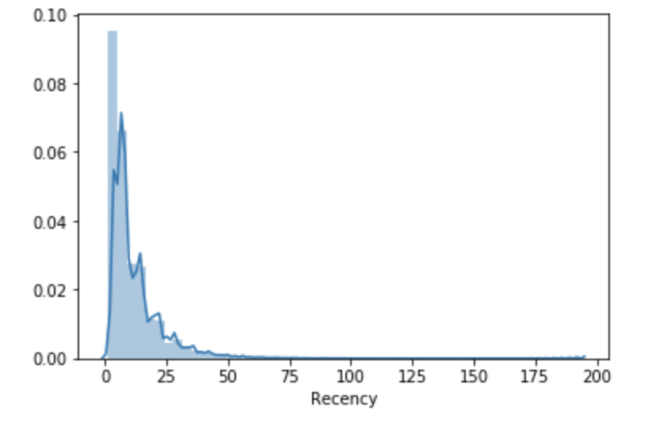
EDA - Recency
Recency is the how many days back the customer has visited the mall.
As per the graph, maximum customers have recently visited the mall.

Slide 6
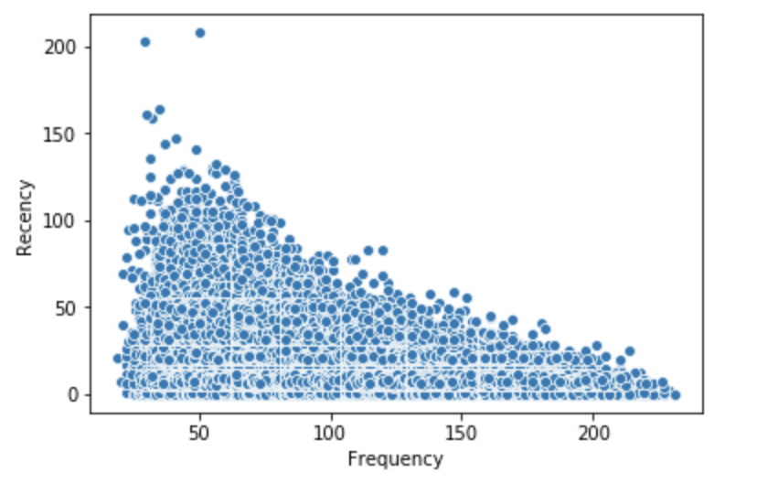
Relationship between the recency and frequency
As seen in this plot, the customers who have high frequency have visited recently to the mall.
Thus the customers on the right side of the plot are more loyal.

Slide 7
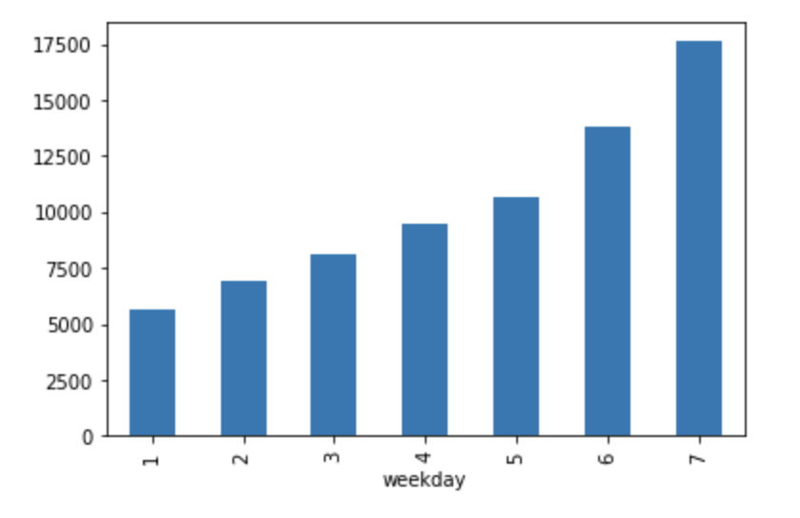
EDA - Most visited weekday of the week
In a particular week, customers prefer to visit on day 7 of the week which is Sunday as per our assumption.
Thus, as obvious the most visits are on the weekend.

Slide 8
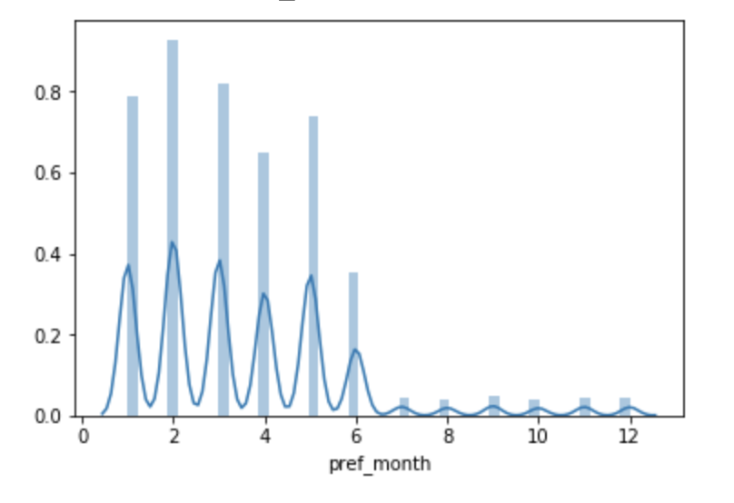
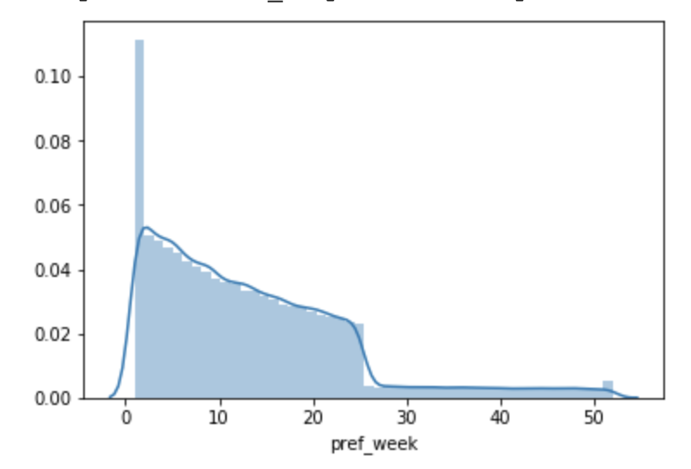
Preferred month and Year of visit
It seems that user prefers to visit the mall in first half of the year.

Slide 9
Approach
To basically create the test train model for this problem, I have divided the dataset into two datasets such that first 903(129 weeks) days data becomes my test train dataset on which I will be doing all feature engineering and modelling. My next 98 days of dataset I have kept such that I will be predicting my customer next visit in next week following 903th day i.e. 130th week. If the customer has not visited in the following week, I have marked the target variable for that customer as 0.
After creating my model using these two datasets, I will be running this model on 1000 days as a whole and will be predicting the customers day of visit in the following week of 1000th day.

Slide 10
Feature Engineering
Since in this dataset, we do not have many features given to us, so I have created some features of my oen using the data I have.
Some basic features created are:
1. Mean difference between the days of visit.
2. Standard deviation of the difference between the days of visit.
3. Frequency of visit.

Slide 11
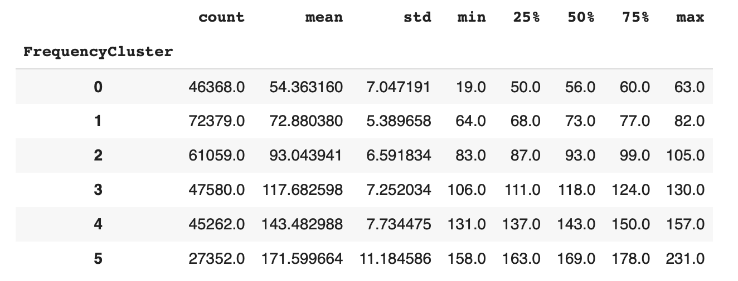
Feature Engineering -- K means
I have created some clusters of frequency and recency and used them as features.
I have used K means to create clusters of frequency and recency.
As seen in the frequency cluster, 5 is the best and 0th is the lowest value of the cluster.

Slide 12
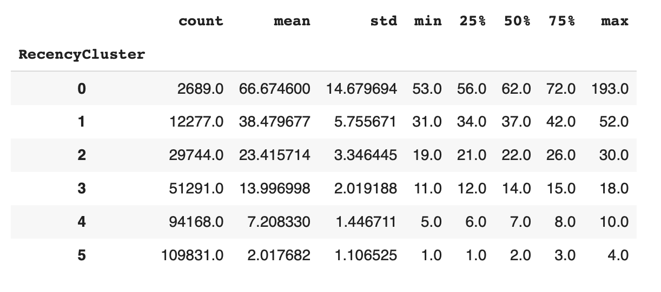
Similarly in the recency cluster, 0 is the lowest value as recency is high and 5th is the best as recency is low.
Both recency and frequency cluster is giving user a value

Slide 13
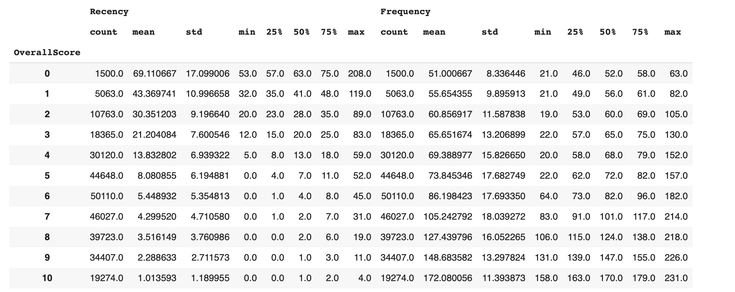
Overall value of the customer
Overall score = Recency cluster + Frequency cluster.
I have created another feature as overall score which the sum of recency cluster and frequency cluster which is actually the Customer Lifetime Value.

Slide 14
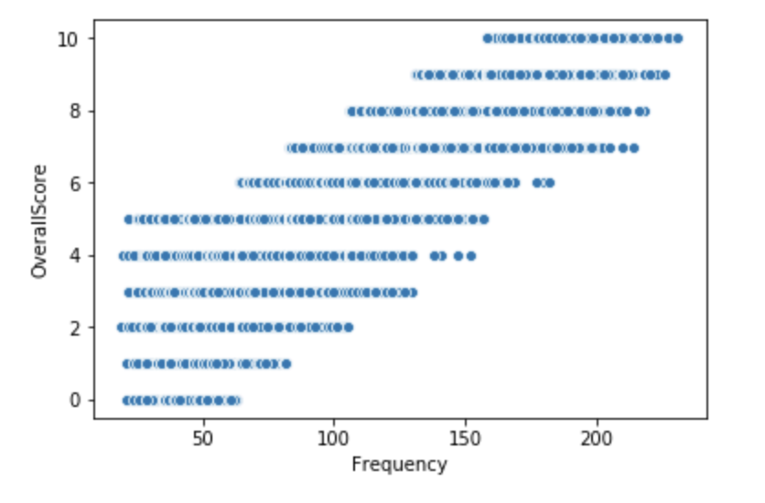
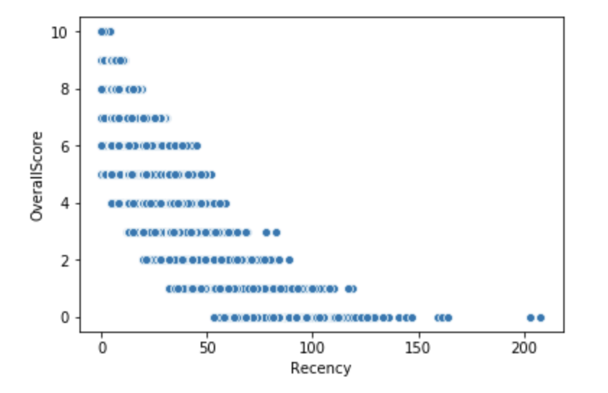
CLV with respect to recency and frequency

Slide 15
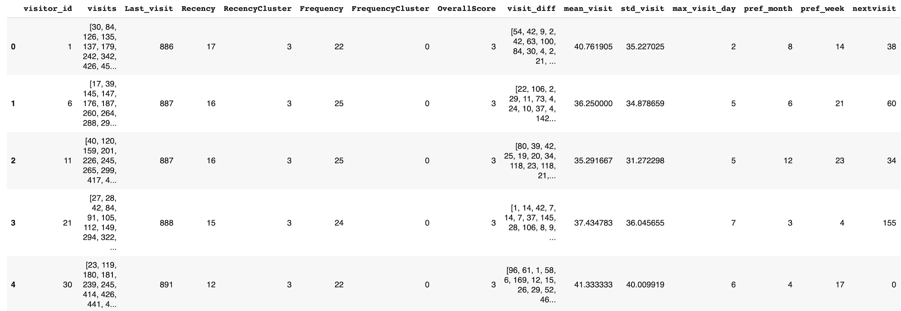
Dataset View
After Feature Engineering, this is how my dataset looks like

Slide 16
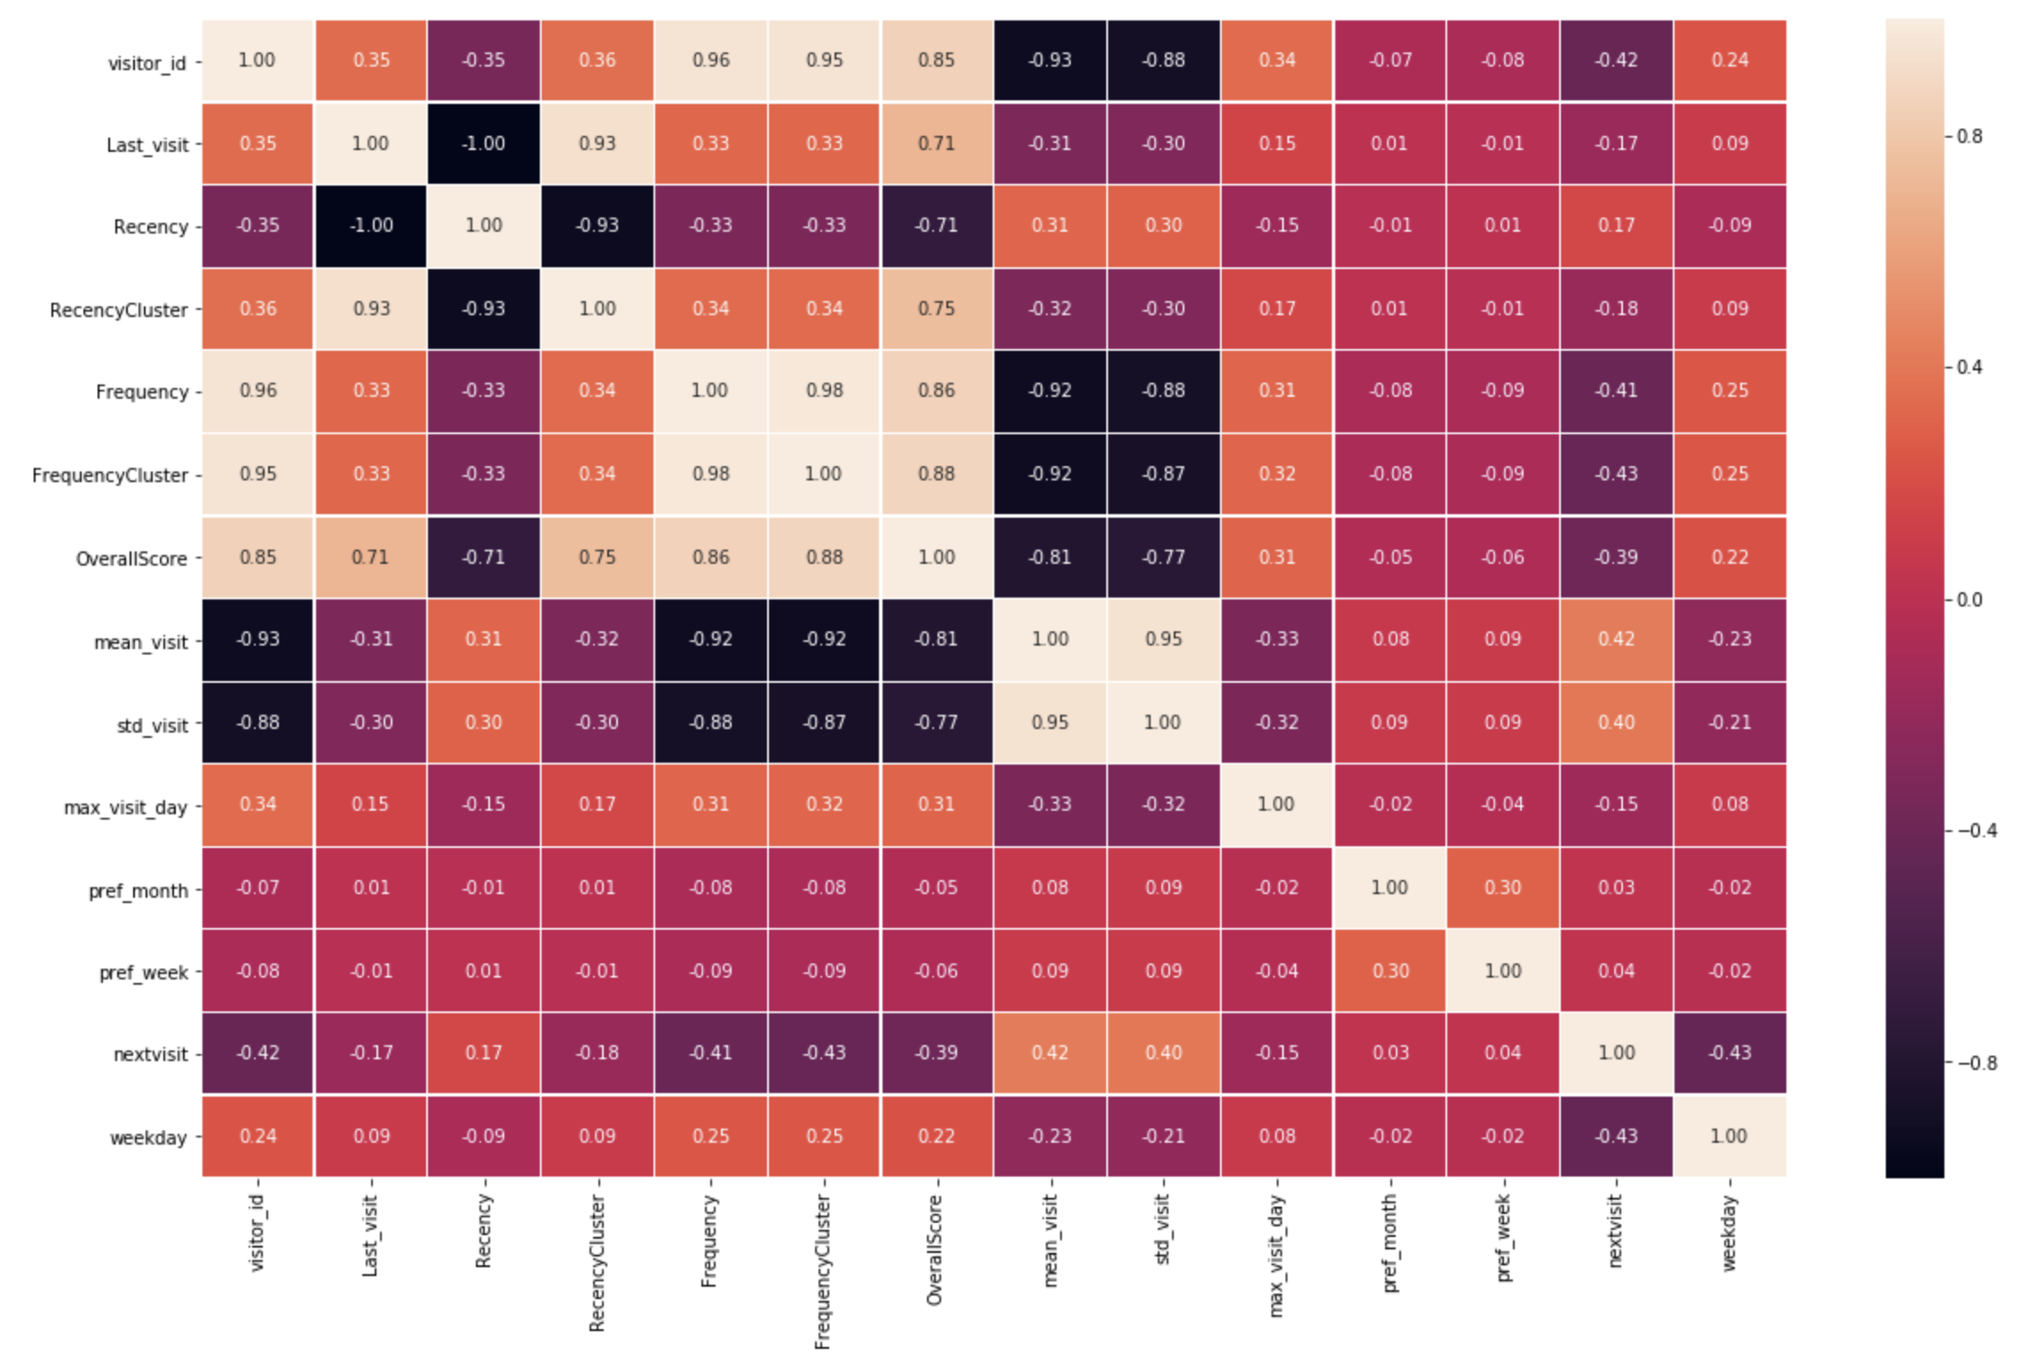
Feature elimination
After studying correlation between the feature in the dataset, we have dropped certain features which are highly correlated and make the learning model bias.

Slide 17
Machine Learning
Time to train the dataset.

Slide 18
Target Variable
We are going to split the dataset in such a way that we will be predicting the day of 130th week user will be visiting the shopping mall.
Target variable : Day of the week
Value ranges from 0-7
0 : user has not visited the mall in 130th week
1-7 : day of the week [monday : sunday]
Thus, it becomes a classification problem and we will be using Xg Boost to solve it.

Slide 19
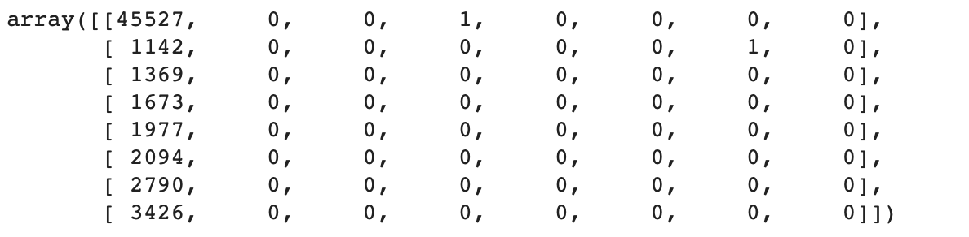
Model 1 : Basic Xg Boost.
Accuracy : 76%..Wohooo
Confusion matrix:
Well, the model is predicting only 0’s..why?

Slide 20
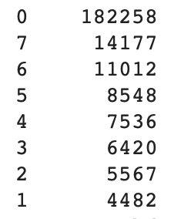
Imbalanced dataset
Well, if we look into the target variable in y_train more than 70% of the data has value 0. I.e. the customer has not visited the mall that week.
Dataset is highly imbalanced and thus the bias comes and model learnt only to predict 0’s.

Slide 21
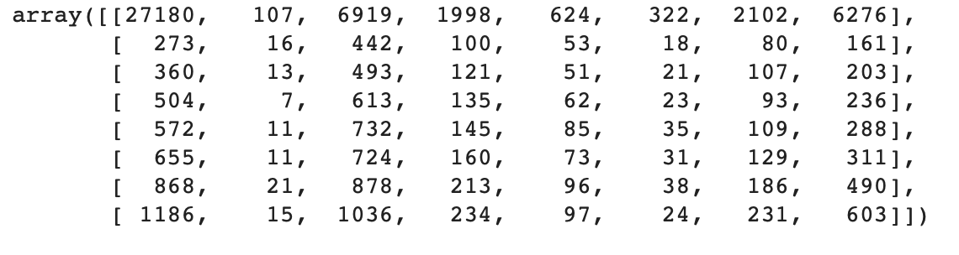
Model 2: Balanced Xg Boost Model
We assigned weights to the models so that maximum occuring variable has minimum weight.
Accuracy : 48%
Confusion matrix:
Much better results, now let us improve the accuracy.

Slide 22
Hyper Parameter Tuning
We opted Grid Search for hyper parameter Tuning to improve the parameters value in XgBoost and get the best accuracy.
After running hyper parameter tuning we found the best parameters as :
({'max_depth': 3, 'min_child_weight': 1}, 0.46038323026677314)

Slide 23
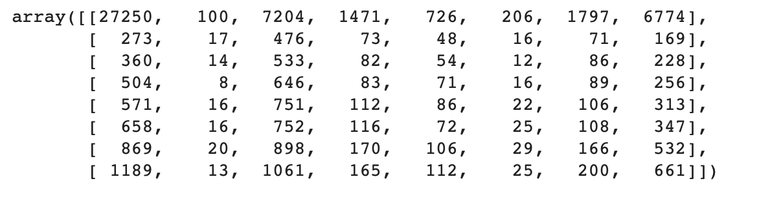
Model 3: Tuned XgBoost
Accuracy : 48%
Confusion matrix:

Slide 24
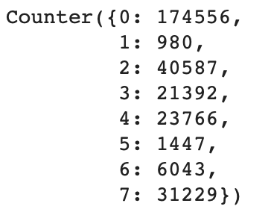
Predicting Customer Visit in 144th week
Using the last model, we will predict the day on which customer may visit the mall in 144th week if he is visiting at all.
After preparing the data, we ran the model on it.
We are able to predict this:
This shows that 980 customers are visiting on weekday 1

Slide 25
Predicting Customer Visit in 144th week
For 1st 10 customers the pattern of visit in 144th week is
[0 0 0 0 0 0 3 0 0 0]
As seen only the 7th customer is visiting the mall on 3rd day i.e. wednesday

Slide 26
Future Work
I wish to run cohort analysis for this data. I will be modifying the dataset for it and will be running some extra analysis for the same.

